Slide 1
Hospital Management System

Slide 2
Project is done by:
1.Ahmed Emad Hosni
2.Mohmmad Kamel
3.Abd-Elrahman Tarek
4.Hossam Mohmad

Slide 3
Supervisors:
PROF. Kamal ElDahshan
DR. Gaber AbuTaleb

Slide 4
*Description:
The Following is ERD OF Hospital database:
- Hospital consists of number of Departments .
+ Each department has Id , name and location.
+ Each doctor Works on Department in a certain shift .
+ Each doctor has :
Id , name , salary , sex , address , medical specialization and phone.
Each Department consists of many Wards
+ Each Ward has id , capacity and availability
- Each Ward can have many nurses .
+ Each nurse has :
id , name , address , sex , salary , shift and phone
+ one of nurses is supervising some nurses(Assign to Ward as supervisor)

Slide 5
- Each patient can occupies ward in a certain interval
[Enter Date , Exit Date]
+ Each patient has :
Id , name , age , address , phone and sex.
+ Doctor Diagnoses the patients (also each patient can has many diagnosis) and write diagnosis and treatments.
- Each patient has one or many Medical record.
:+ Each Record has
Record Number , Date , diagnosis and Treatments.
+Each patient pay Bill.
+ Each bill has id , total bill and amount.
+ bills are generated by accountant.
- Each accountant has :
id , name , phone , sex , address , shift , and salary .

Slide 6
Entity relationship diagram

Slide 7
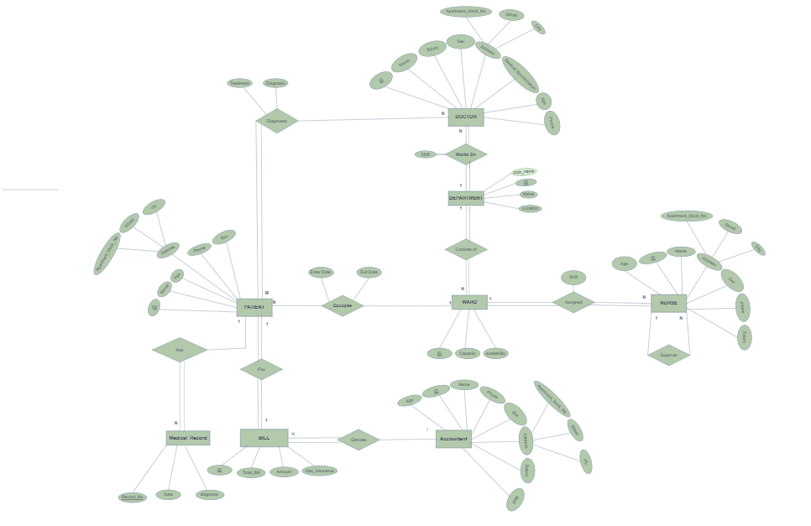

Slide 8
Relational Model
After Mapping

Slide 9
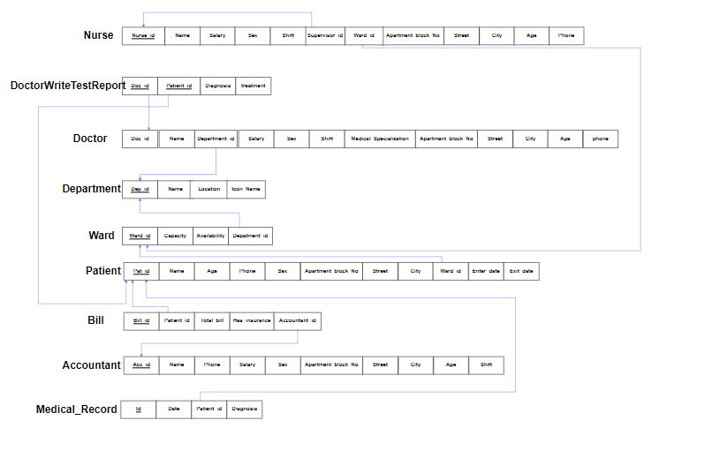

Slide 10
Normalization :

Slide 11
Nurse Relation is:
1]In First Normal Form:
Because it's attributes are Single value
(nurse relation does not contain any multivalued attribute , Composite attribute ,nested relation)
2]In Second Normal Form :
Because Each non prime attribute in Nurse Relation is functionally dependent of prime key attribute
3]In Third Normal Form :
Because it is in second normal form and Each no non-prime attribute in Nurse Relation is Transitively dependent on the primary key.
SO Nurse relation is in third normal form.

Slide 12
That Also satisfying to all database relation
So hospital database is in third normal form
User Interface :

Slide 13
Welcome page of Interface

Slide 17


Slide 19
Patients pages

Slide 21
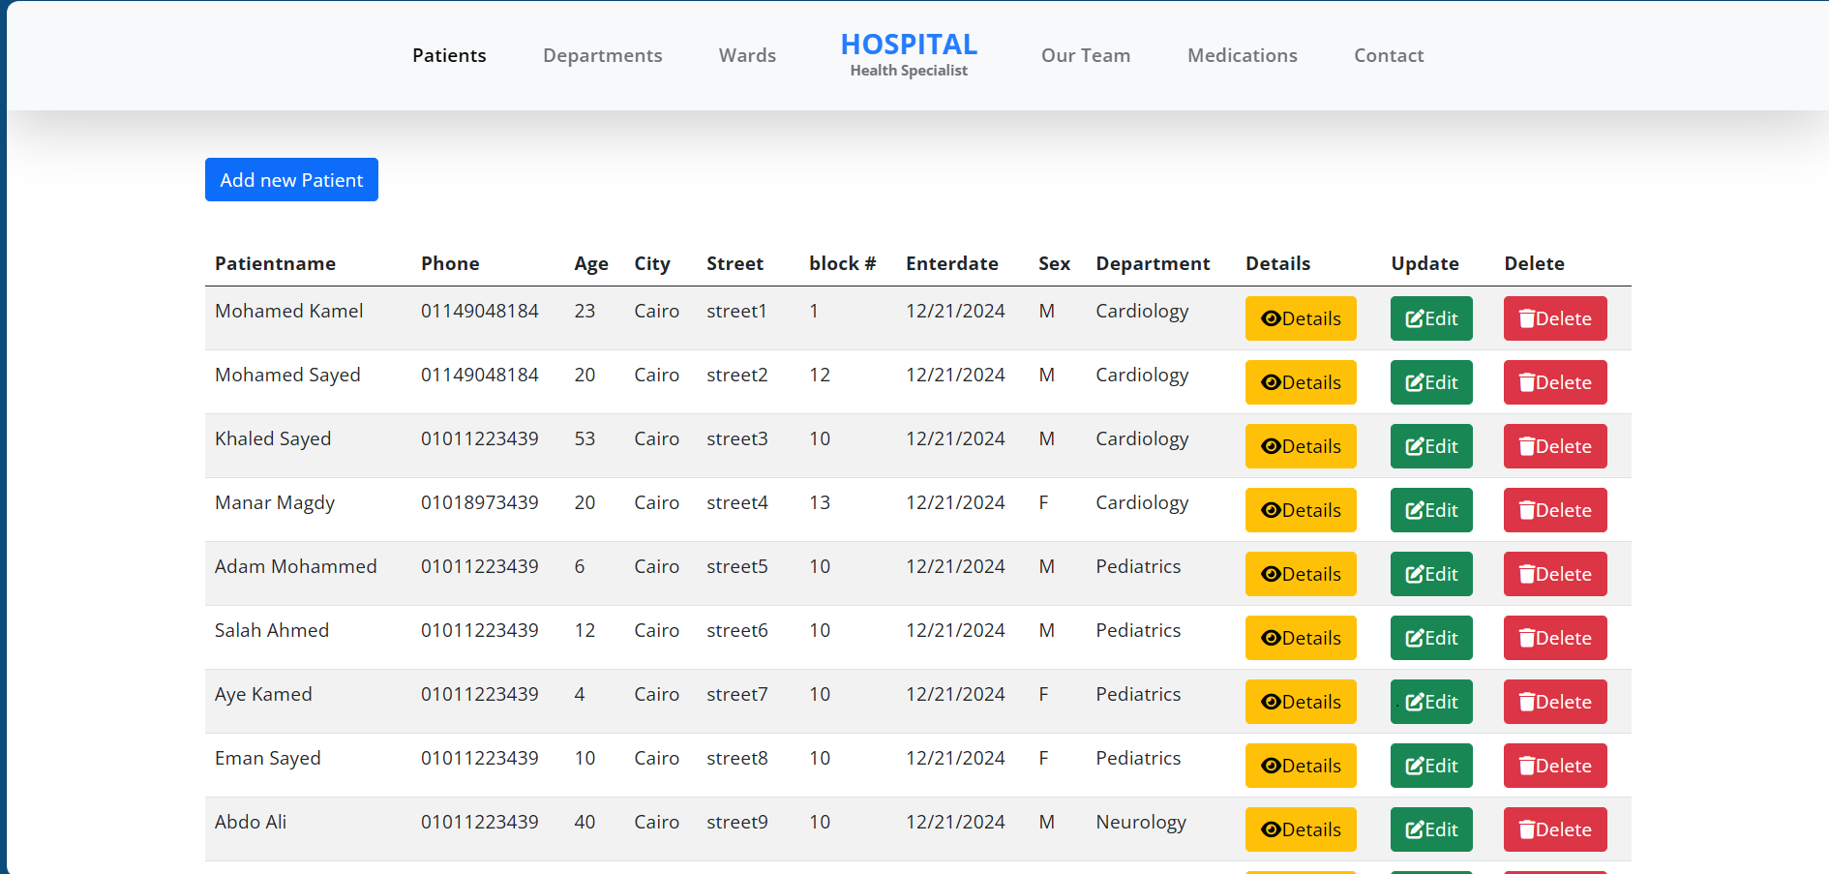

Slide 22
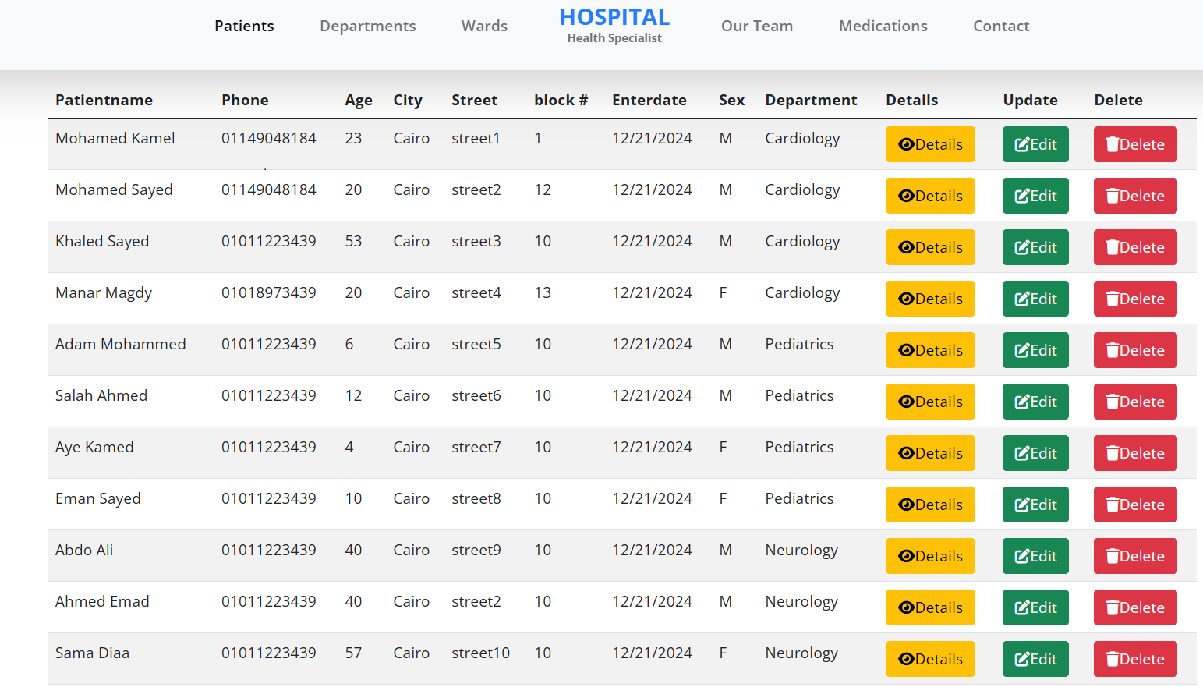

Slide 23
Wards

Slide 24
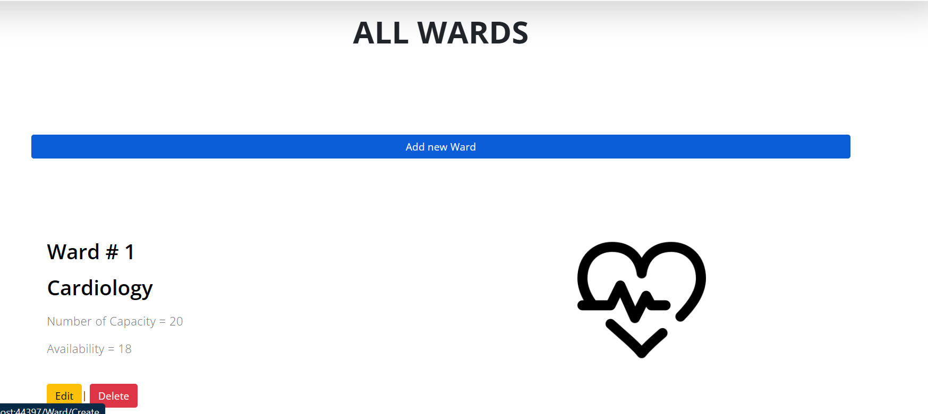

Slide 25
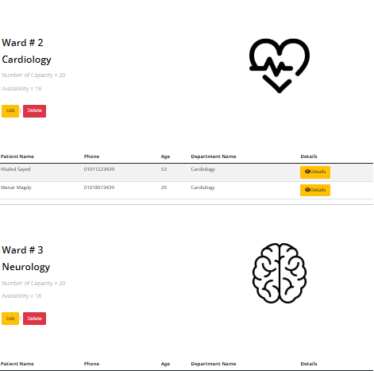

Slide 26
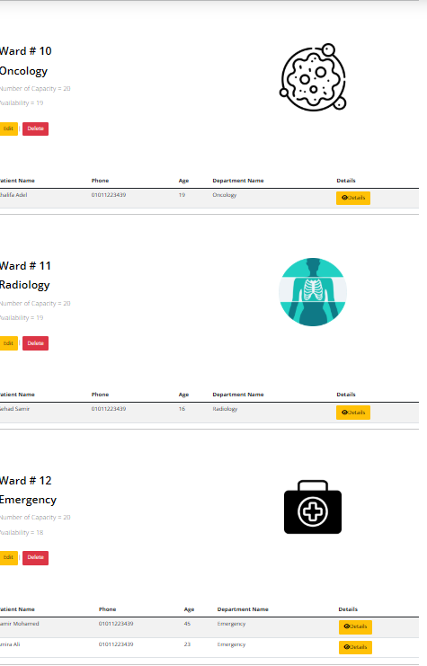

Slide 27
departments

Slide 28
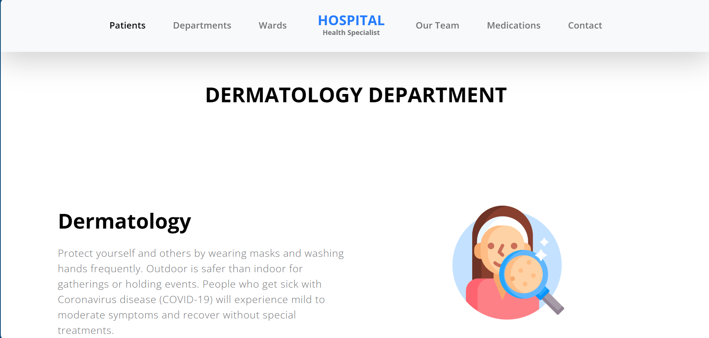

Slide 29
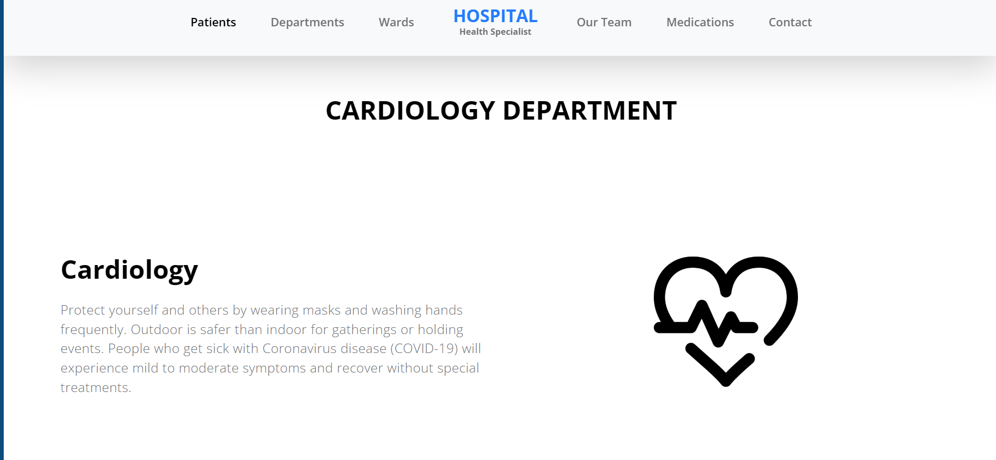

Slide 30
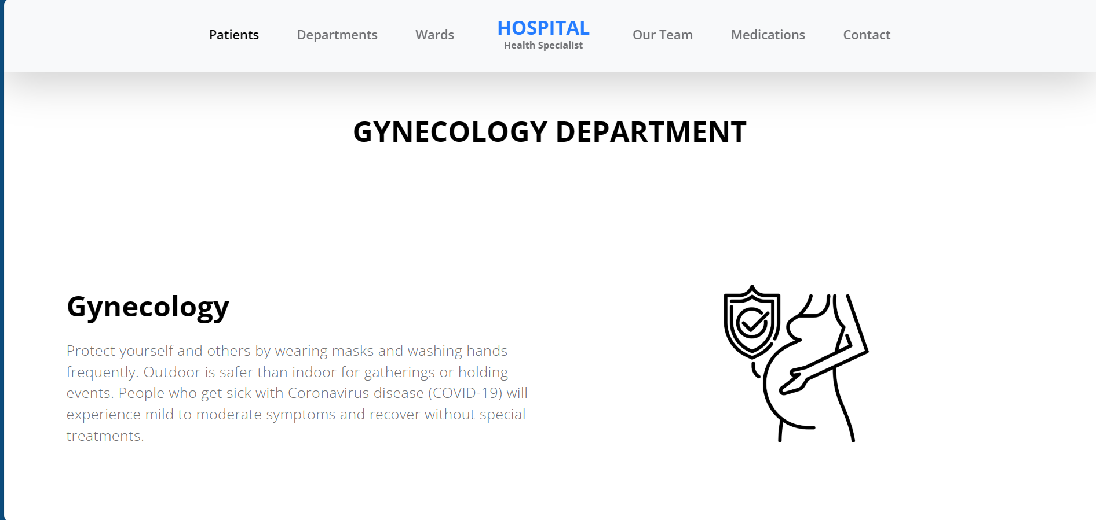

Slide 31
All Staff

Slide 32
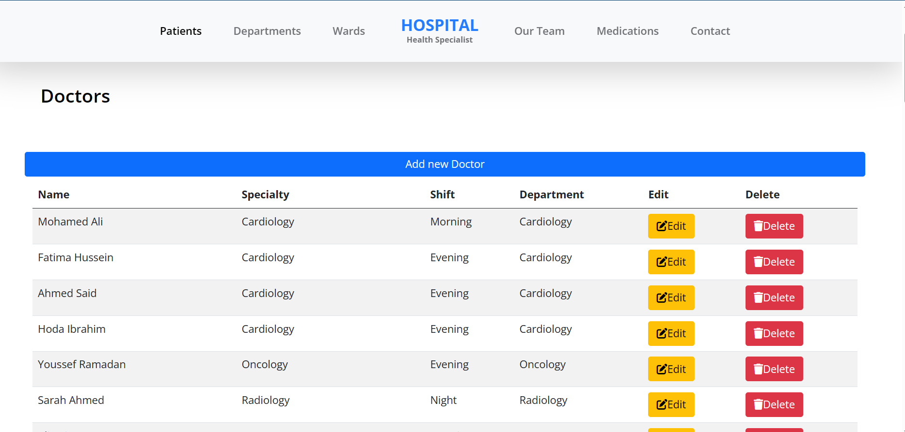

Slide 33
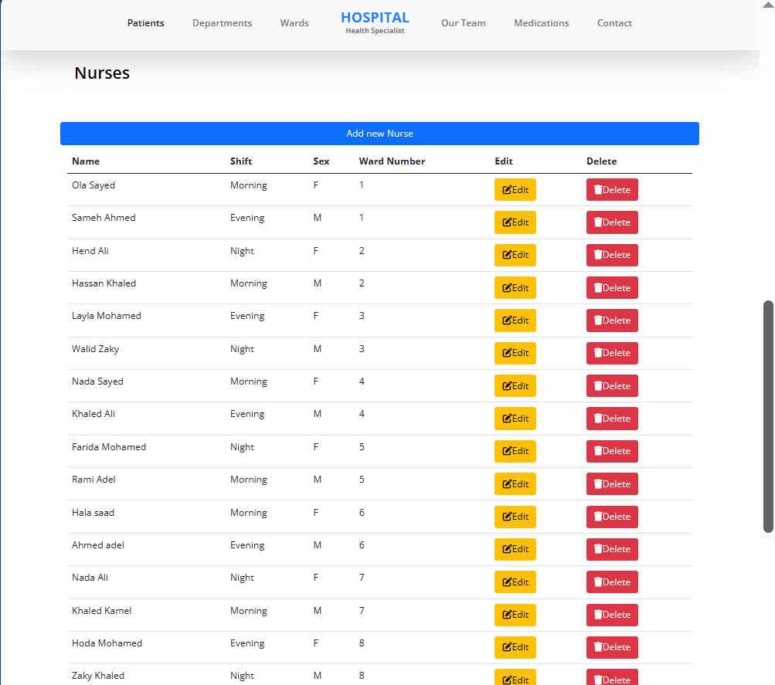

Slide 34
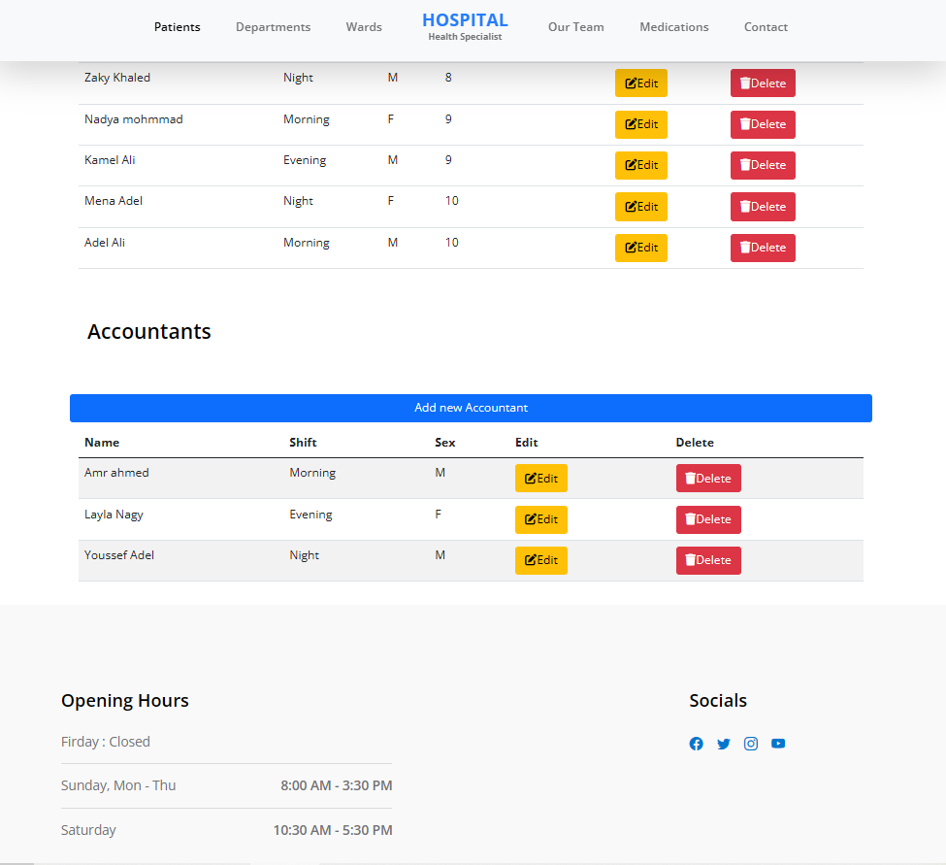

Slide 35
Thank you

Slide 36


